Slide 1
Individual Homework - Logic Circuits
Ciama Andreea, group 911

Slide 2
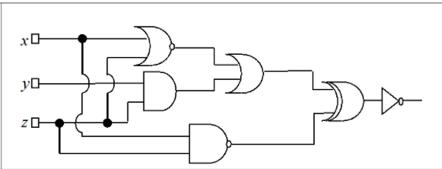
Problem Statement
Write the corresponding Boolean function associated to the following logic circuit, then simplify it and draw a simplified equivalent circuit using only basic gates

Slide 3
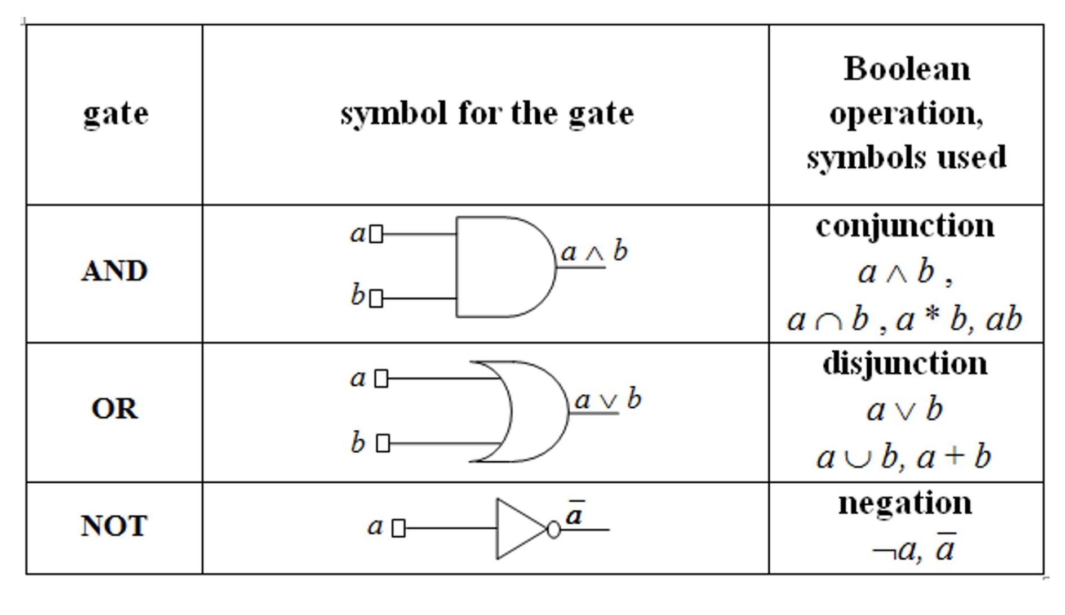
Theory - 1
Binary Boolean algebra provides a concise way to express the operation of a logic circuit formed by a combination of logic gates so that the output can be determined for various combinations of input values.
A gate takes the values from its input wires and combines them with the appropriate Boolean operation to produce the label on its output wire

Slide 4
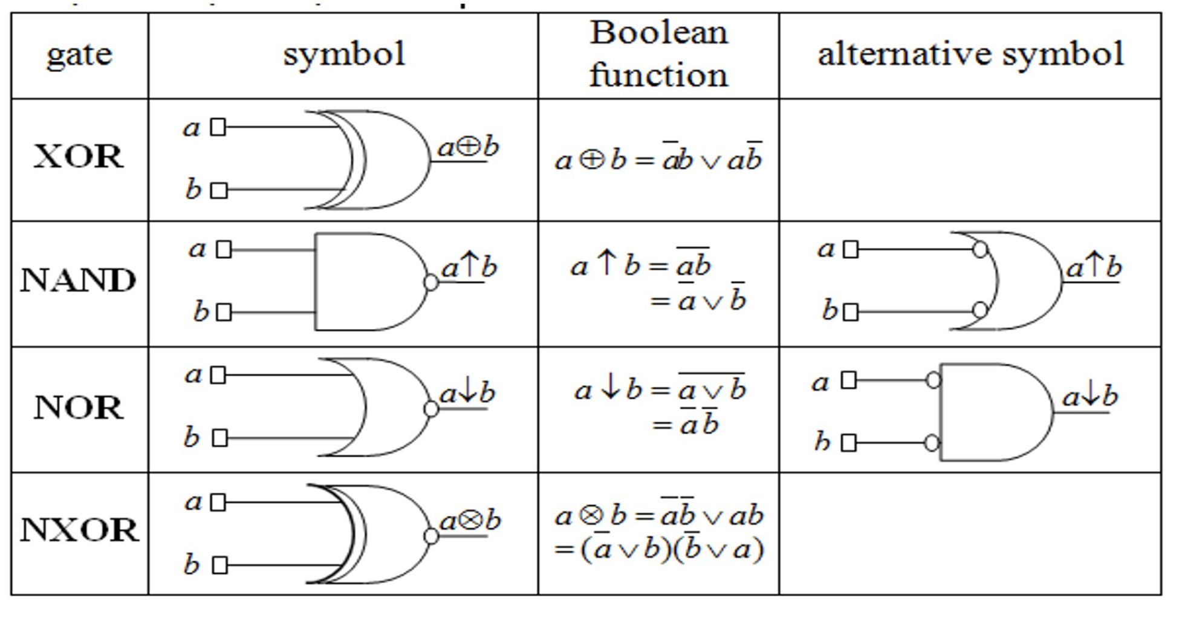
Derived Gates

Slide 5
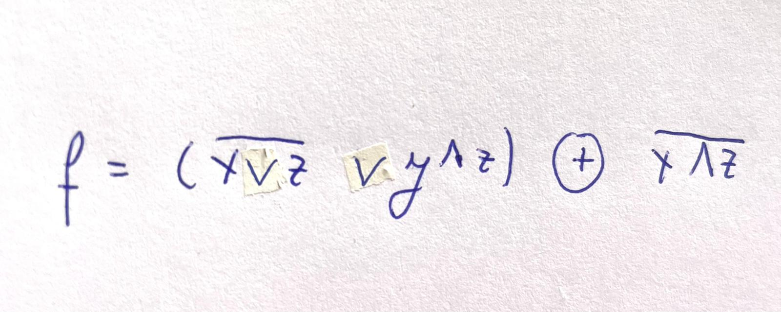
The corresponding function associated with the logic circuit

Slide 6

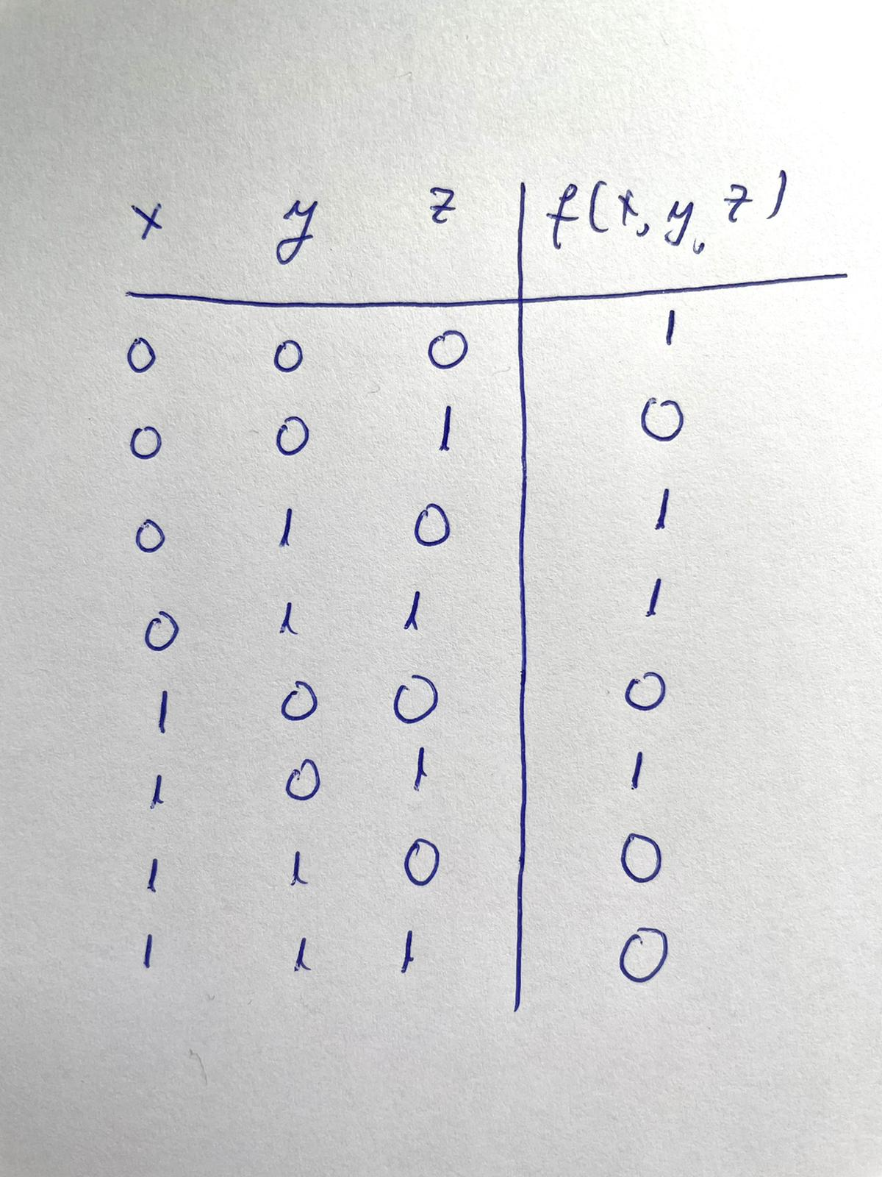
Truth table

Slide 7
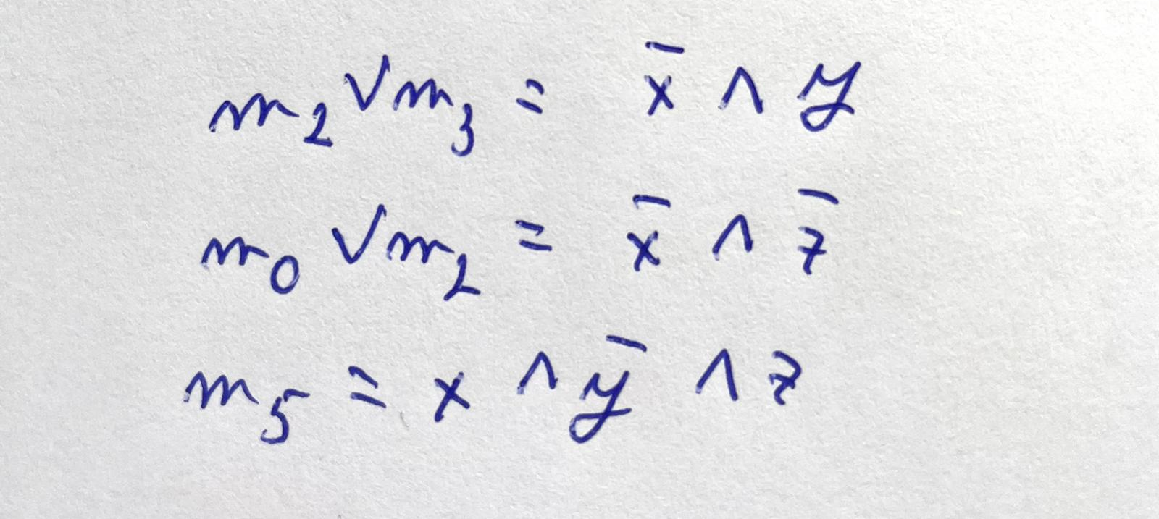
Maximal monoms

Slide 8
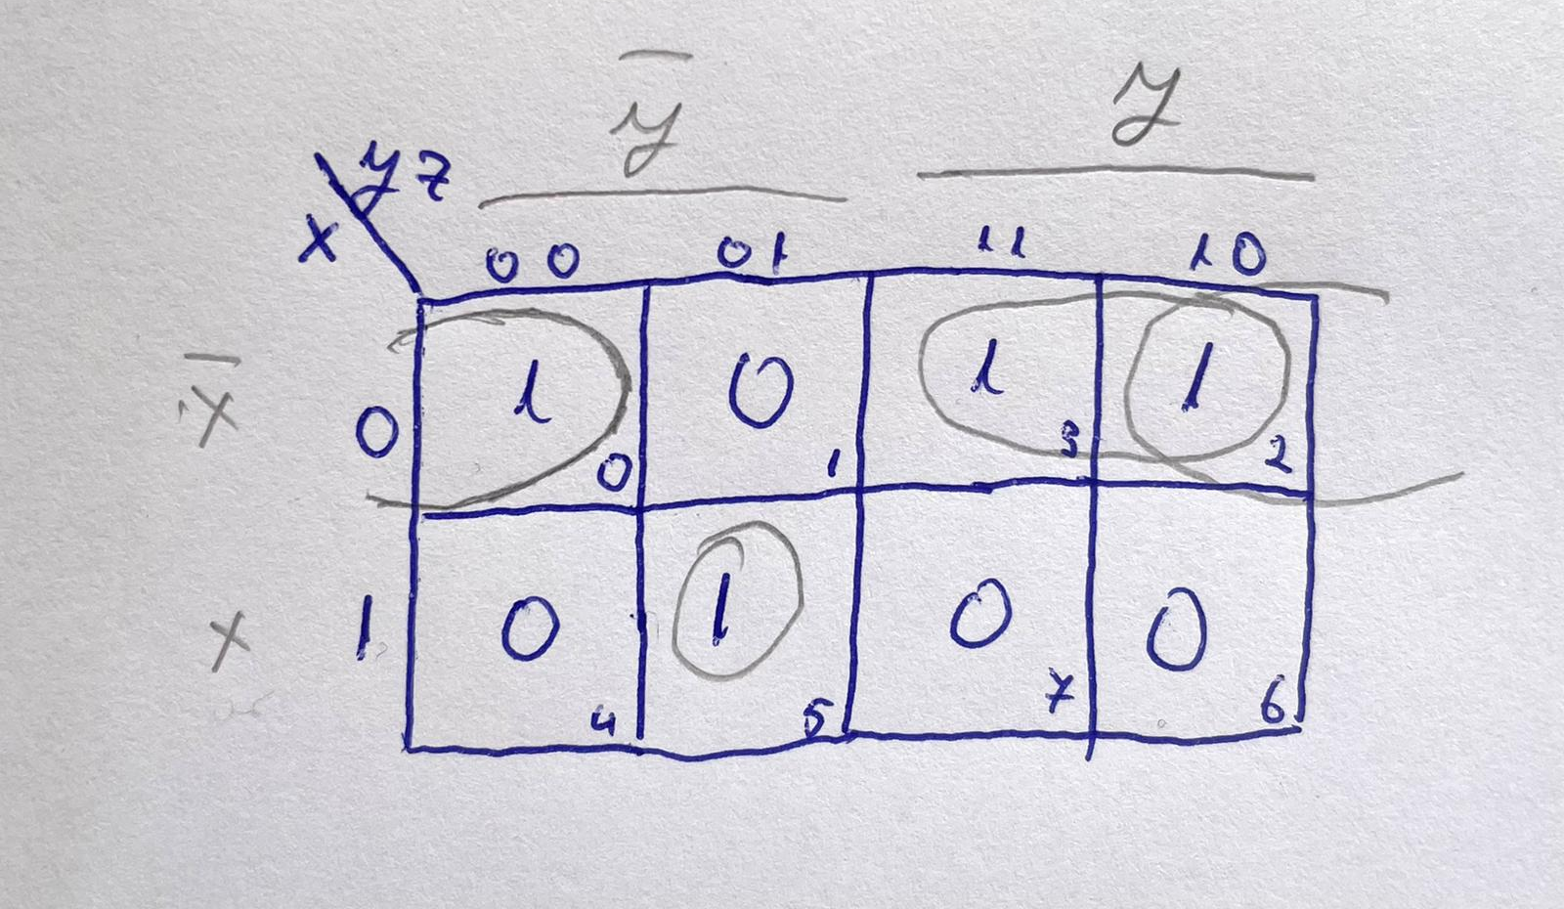
Karnough diagram

Slide 9
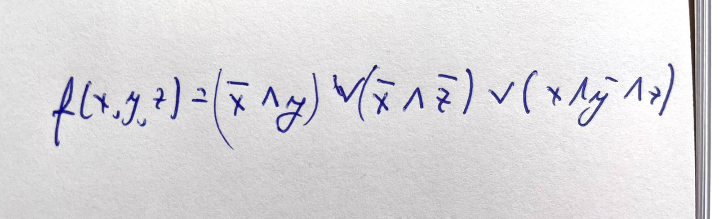
The corresponding function associated with the simplified logic circuit

Slide 10
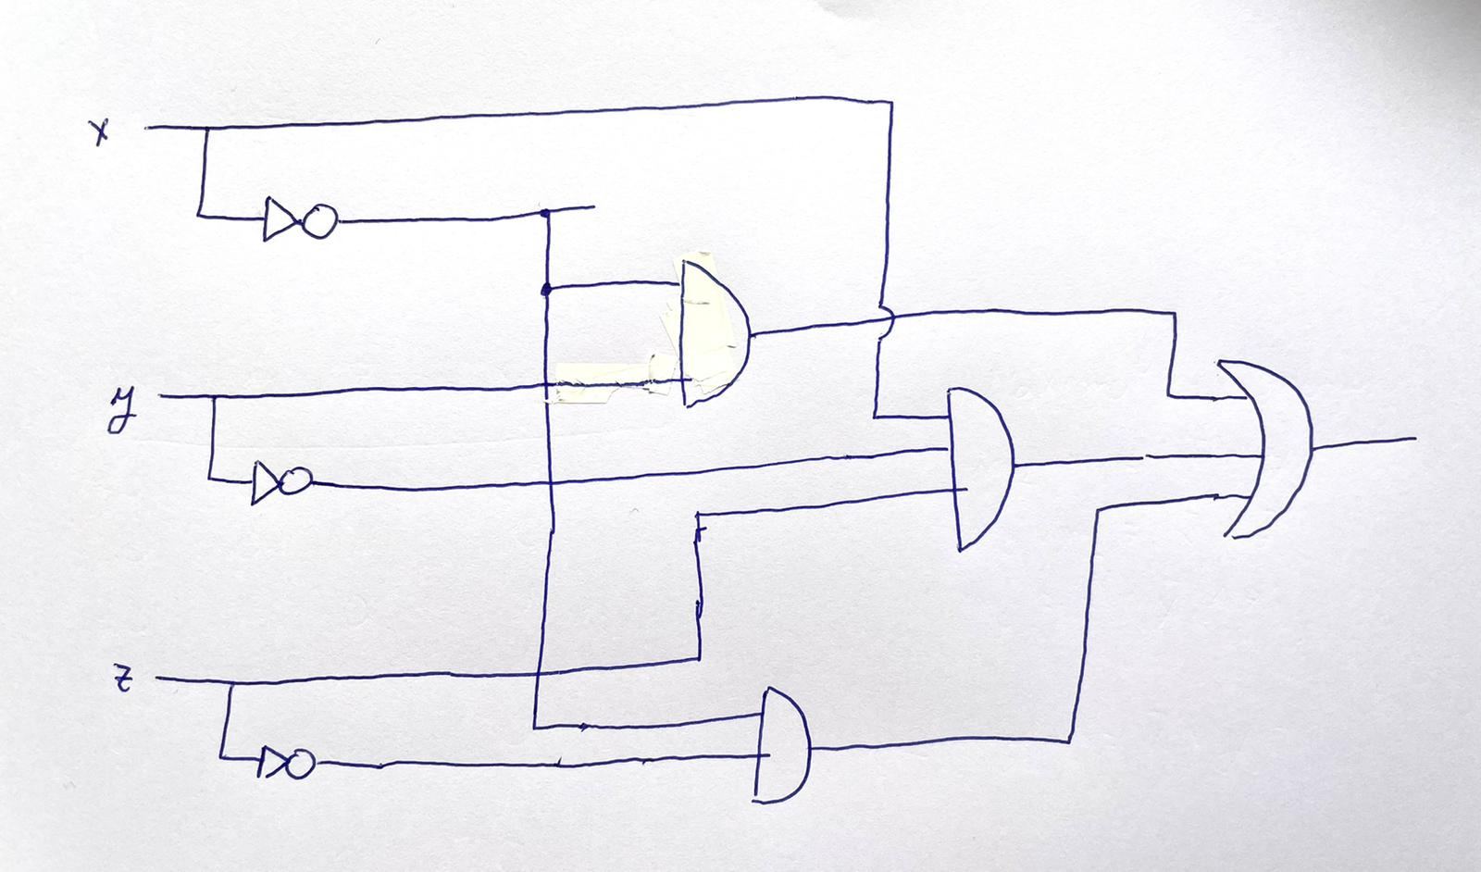
Simplified equivalent circuit with basic gates

